Slide 1

Final Presentation
EIN6510 - Principles of Manufacturing Systems Engineering
Team 2 - G²
Chenchu Sakthi Charan Kondugari, Chad Tucker, Samrudh U P, Chenyu Yang

Slide 2
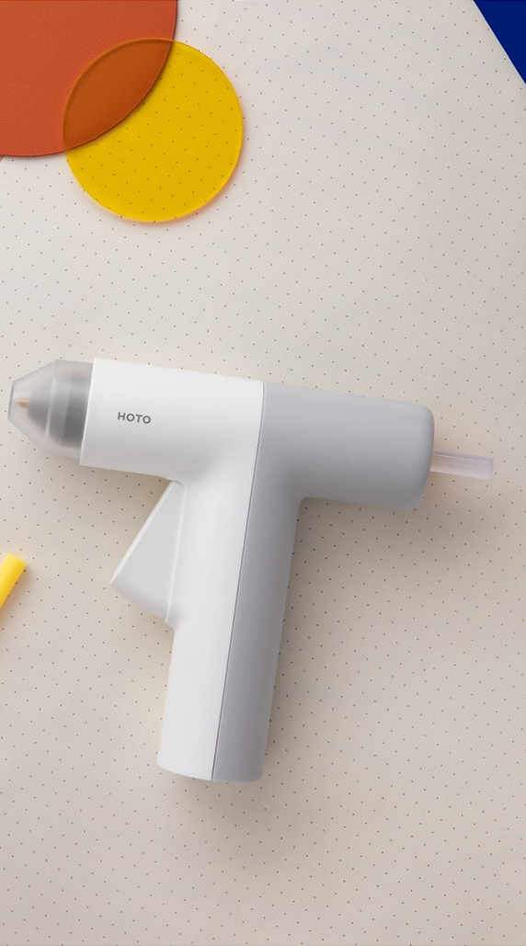
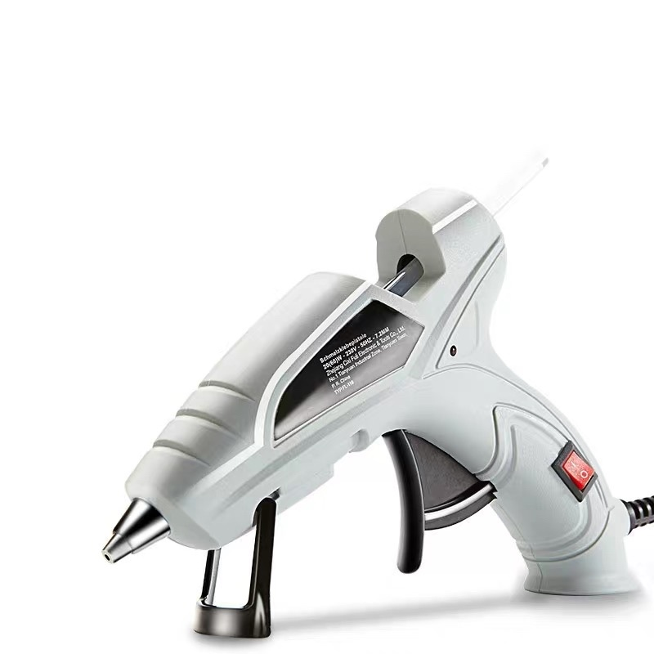
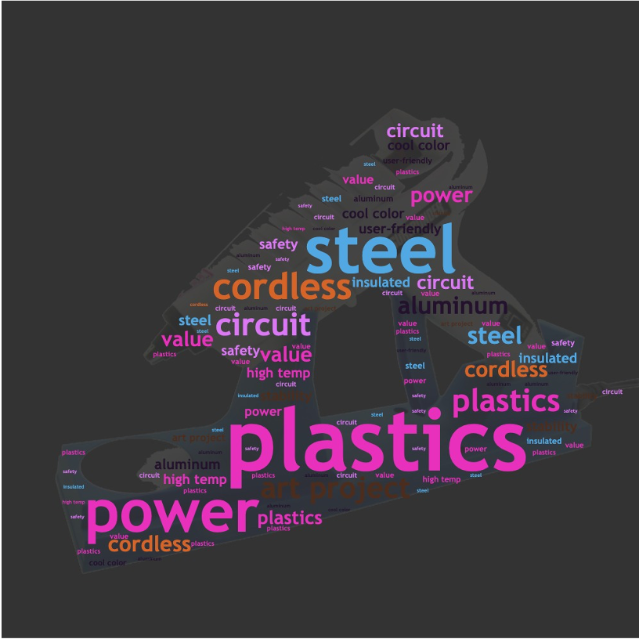
Product Prototype

Slide 3
Market of Glue Gun
The Global Glue Gun market grows rapidly, especially under the COVID-19 outbreak.
Innovation of technology, safety, and variety of glue gun led to more application scenarios.
The explosive growth of users’ demand greatly enriches the application scenarios of glue gun.

Slide 4
Customer Survey
Questions include:
How often do you routinely make crafts as a hobby or fun?
How important is it if the product (glue gun) is easy to control?
How important is it if the product has a long battery life?
How important is it if the product is light weight?
……

Slide 5
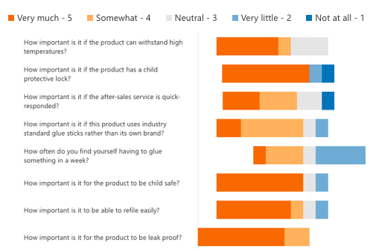
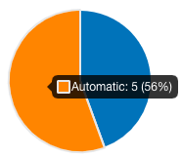
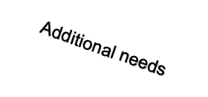
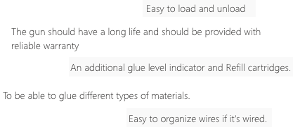
Result Summary

Slide 6
House of Quality
Rank | Engineering Requirements
1 | Number of Components
2 | One button to dispense glue stick
3 | Modular and able to glue small areas
Accessibility
Reliability
Safety
Service

Slide 7
Product Specifications
Compact size, less components
Lightweight
Long battery life
Insulation outershell
Plastic and metal combination for the body with a rubber grip
Modular and removeable parts
Easy to clean
Size of glue sticks used should be in the normal standard
Supports different sizes of nozzles for varying glue dispense

Slide 8
Metrics and Target Values
Compact size, less components
Lightweight
Battery life
Insulation outershell
Plastic and metal combination for the body with a rubber grip
Modular and removeable parts
Size of glue sticks used should be in the normal standard
150 x 130 x 40 (mm)
< 200 g
> 3 hours
ABS plastics as raw material
Standard size of glue gripper

Slide 9
Architectual and Detailed Product Design

Slide 10
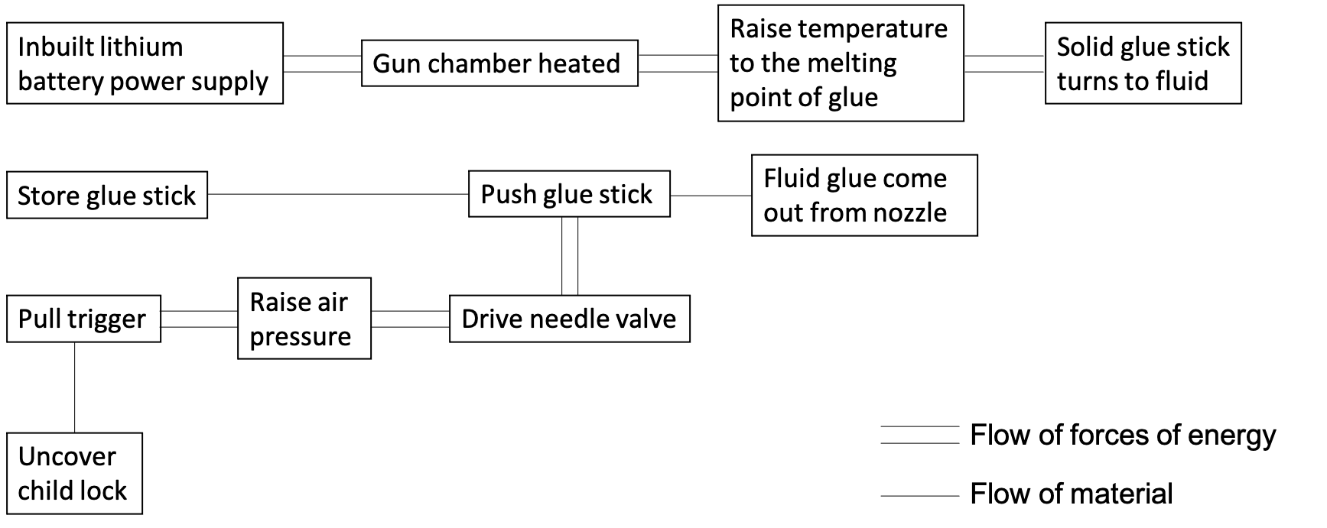
Product Schematic
Spring
Release
Drive spring

Slide 11
Specifications of Components
Internal
Circuit board – provided by suppliers; support energy transformation
Coupler – provided by suppliers; support energy transformation
Spring steel – provided by suppliers; durable and flexible
Linkage – durable
Gripper – strong
External
Tip – withstand high temperature (>M.P. of glue)
Trigger – durable
Outer shell – strong

Slide 12
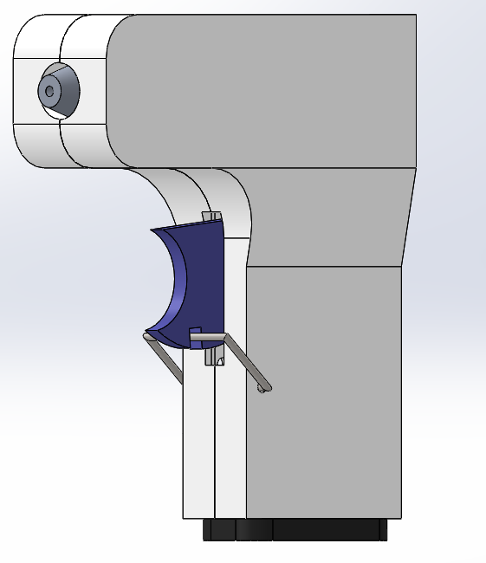
CAD Drawings
Glue tip which controls flow rate of glue out of the device
Accepts standard size glue sticks
Centered Mounted Trigger
Child Lock Mechanism
Inbuilt battery Pack

Slide 13
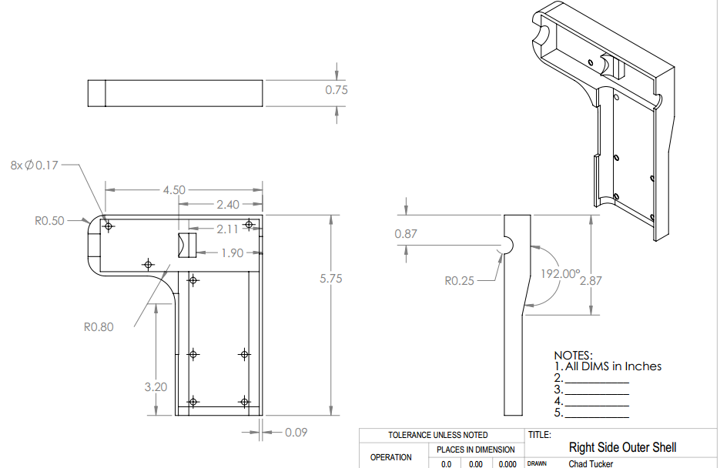
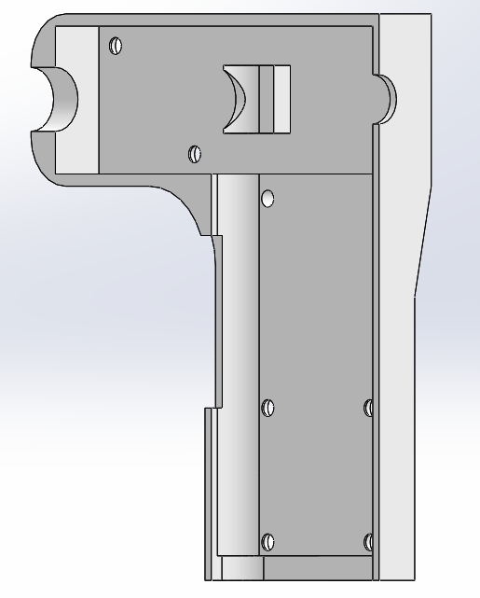
CAD Drawings

Slide 14
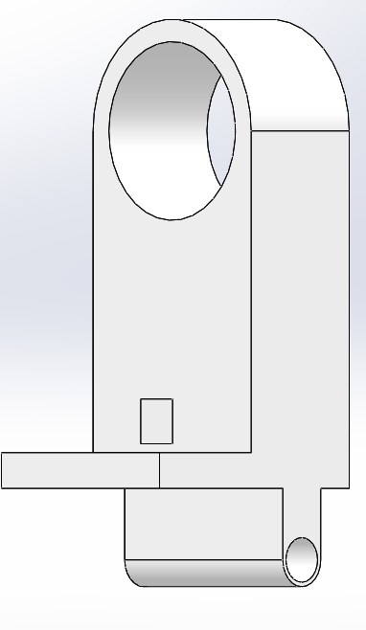
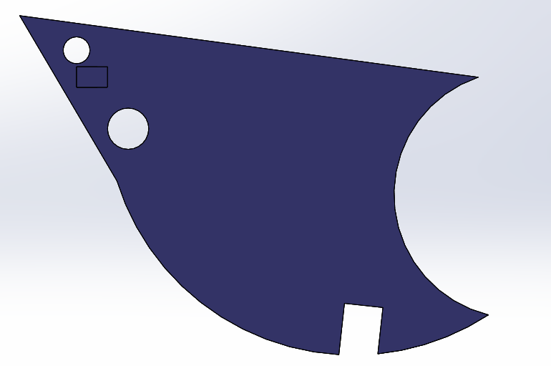
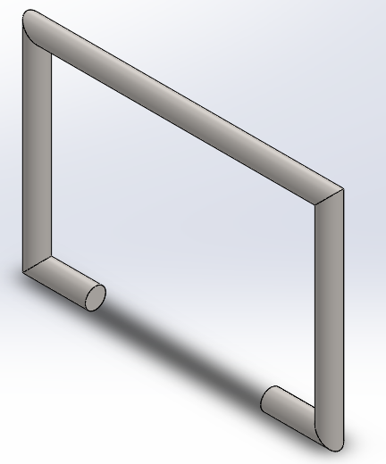
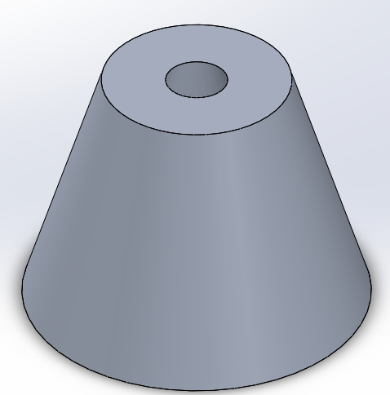
CAD Drawings
Trigger
Gripper
Safety Lock
Tip

Slide 15
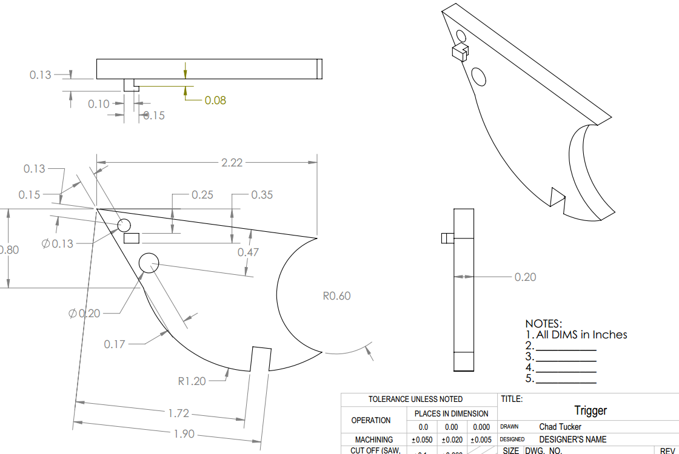
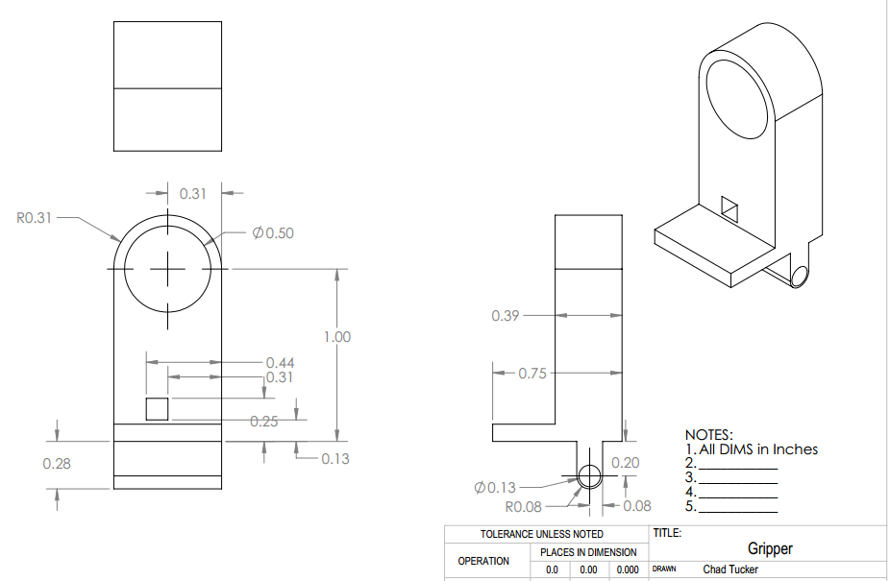
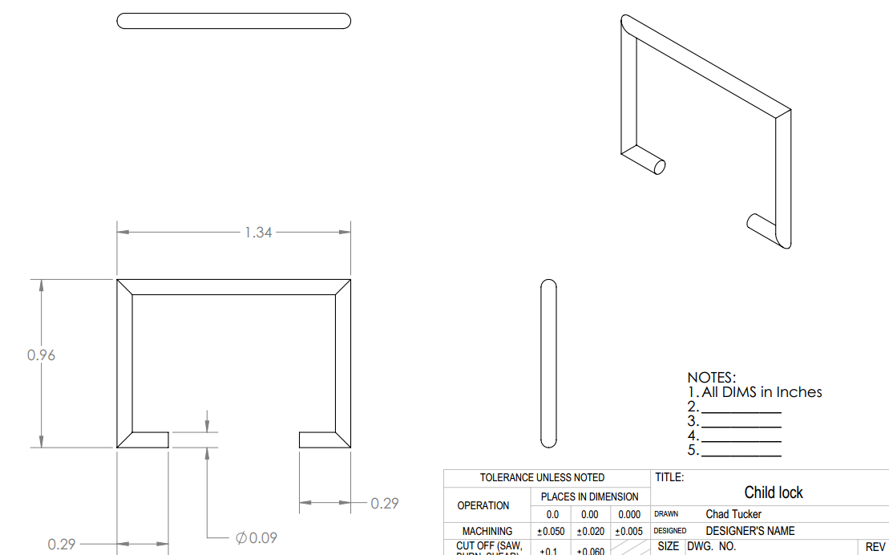
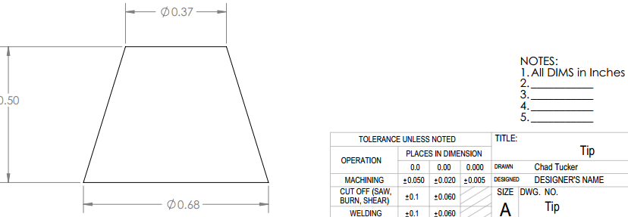
CAD Drawings

Slide 16
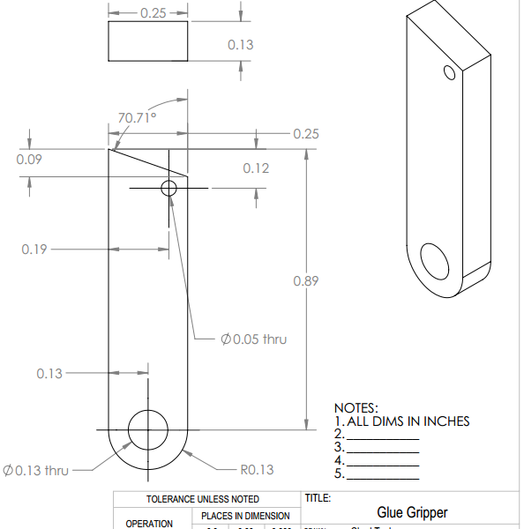
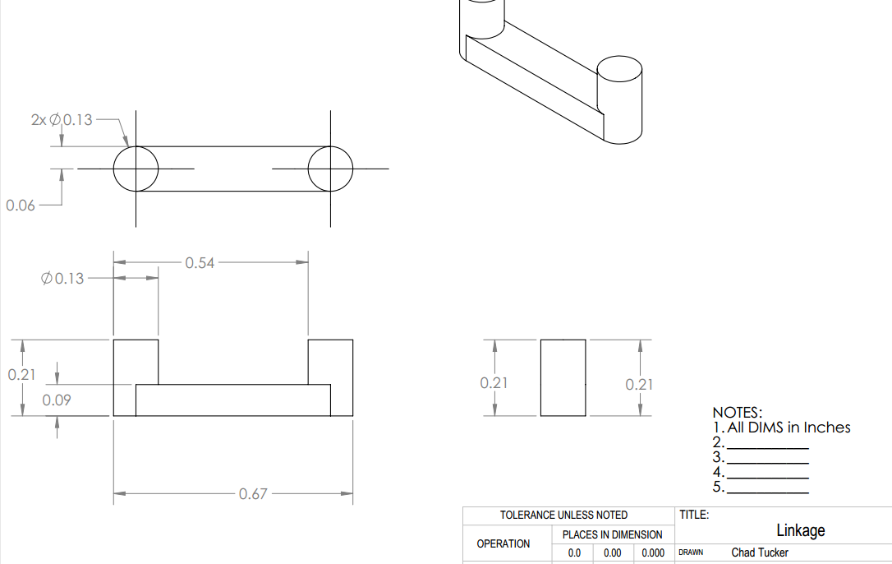
CAD Drawings

Slide 17
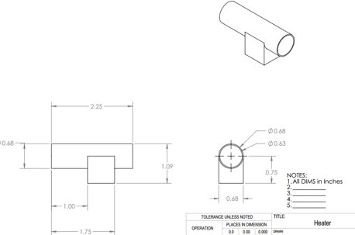
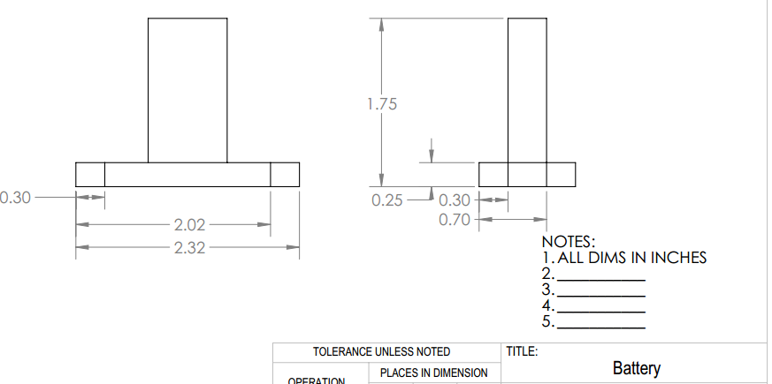
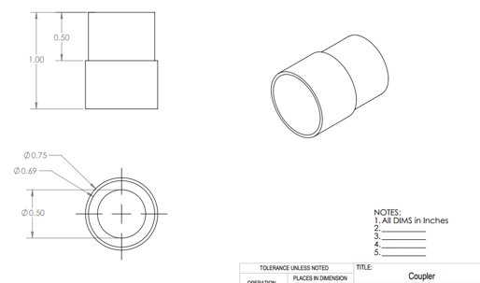
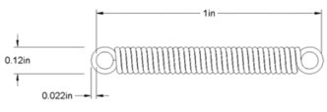
COTS PARTS
Wiring from the Battery to the Heater
Battery
Compression Spring
Coupler
Heater

Slide 18
Bill of Materials
Part | Material | Commercial-off-the-shelf (COTS) | Manufactured | Part number
Tip | 6061 Aluminum | Yes
Trigger | ABS Plastic |  | Yes
Linkage | ABS Plastic |  | Yes
Gripper | ABS Plastic |  | Yes
Coupler | Galvanized steel | Yes |  | Mcmaster Part Number 7903N138
Child Lock | Carbon steel |  | Yes
Right side shell | ABS Plastic |  | Yes
Left side shell | ABS Plastic |  | Yes
Spring | Spring steel | Yes |  | Mcmaster Part Number 5108N003
Heater | Steel | Yes

Slide 19
Make/Buy Analysis
Part | Material | Commercial-off-the-shelf (COTS) | Manufactured | Cost of the material (per lb.) | No of unites produced per lb. | Wastage per lb. | Material cost per unit
Trigger | ABS Plastic |  | Yes | $1.50 | 20 | 10% | $0.08
Linkage | ABS Plastic |  | Yes | $1.50 | 40 | 10% | $0.04
Gripper | ABS Plastic |  | Yes | $1.50 | 12 | 10% | $0.14
Right side shell | ABS Plastic |  | Yes | $1.50 | 8 | 25% | $0.47
Left side shell | ABS Plastic |  | Yes | $1.50 | 8 | 25% | $0.47
Glue gripper | ABS Plastic |  | Yes | $1.50 | 15 | 15% | $0.12
Spring | Spring steel | Yes |  |  |  |  | $2.38
Battery | Lithium-ion type | Yes |  |  |  |  | $4.50
Heater | Steel | Yes |  |  |  |  | $2.34
Coupler | Galvanized steel | Yes |  |  |  |  | $0.24
 |  |  |  |  |  | Total | $10.77

Slide 20
Make/Buy Analysis
Cost of Mold | Life of mold (#of presses) | Number of cavities | Cost of mold per part | Number of parts manufactured in one hour | Direct labor cost on each part
$3,000.00 | 125,000 | 4 | $0.02 | 200 | $0.06
$3,000.00 | 120,000 | 4 | $0.03 | 250 | $0.05
$5,500.00 | 125,000 | 3 | $0.04 | 200 | $0.06
$9,000.00 | 120,000 | 2 | $0.08 | 100 | $0.13
 |  | 2 |  | 100 | $0.12
$3,600.00 | 125,000 | 4 | $0.03 | 250 | $0.05
Total $24,100.00 | 615,000 |  | $0.20 |  | $0.48

Slide 21

Make/Buy decisions
Cost per unit = Material cost + Direct labor cost + indirect labor cost
Estimating the indirect cost = Fringe benefits + indirect labor cost
Fringe benefits = 44% of direct labor cost.
Indirect cost = 120% of direct labor cost.

Slide 22
Make/ buy decision
Total labor cost per unit = Direct labor cost + indirect costs = 2.64 * Direct labor cost = 2.64*0.48= $1.27
Total post of production (in house)= Material cost + Labor cost = 10.77 + 1.27 = $12.03
Total Cost = 12.03 * 50,000 = $601,500
Proposed cost for manufacturing ABS plastic components by T&A = 2.62 * 50,000 = $131,000
Total Cost = 131,000 + COTS parts =131,000 + (9.46 * 50,000) = $604,000
Therefore, we have decided to manufacture the ABS plastic components in house.

Slide 23
Process Design

Slide 24
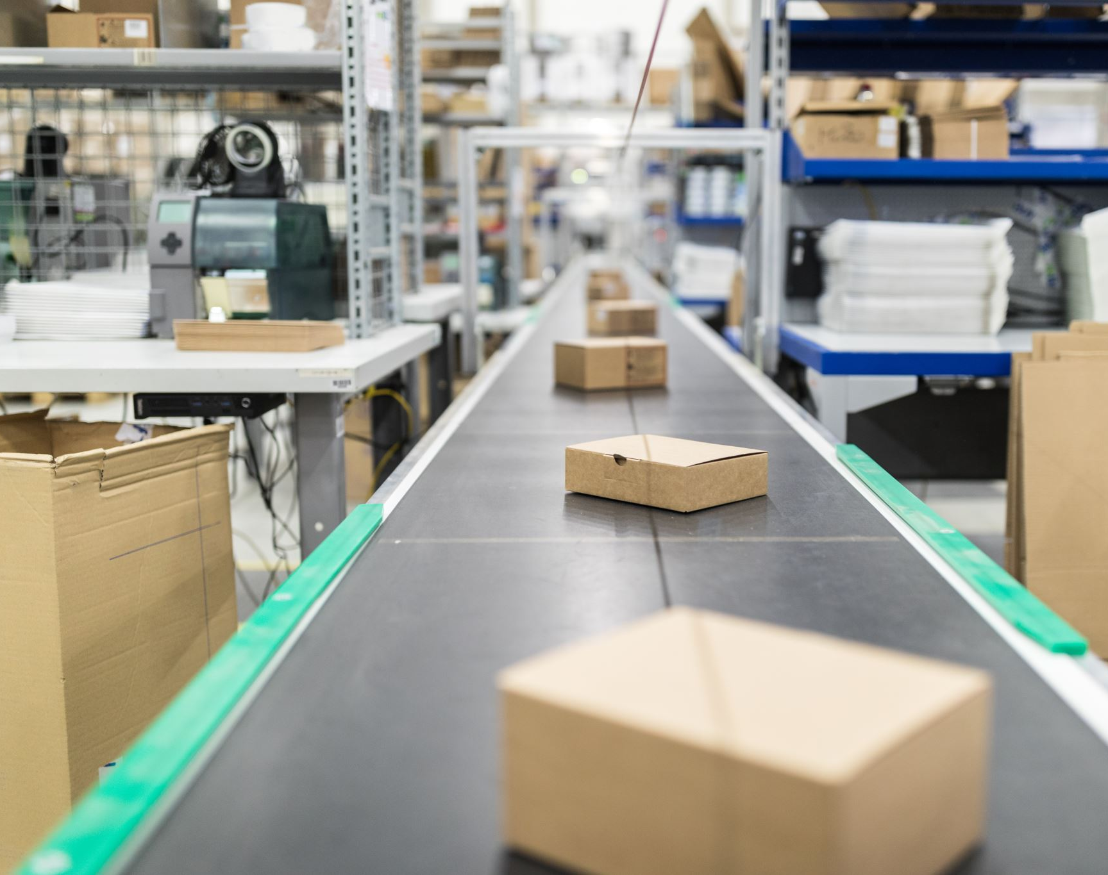
2. Machines for Manufacturing
In-house Processes
Manufacturing plastic components
ABS
Injection Molding Machine
Assembly line
Conveyor Belt

Slide 25
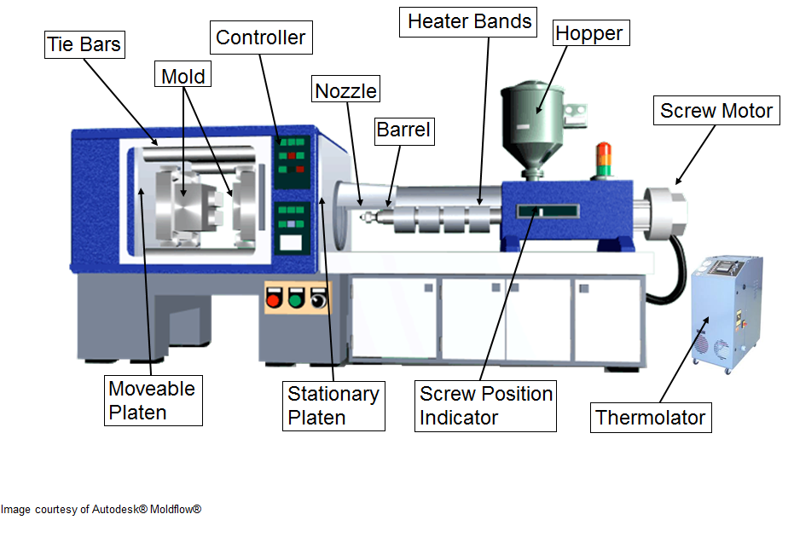
Injection Molding Machine
An injection molding machine is a machine for manufacturing plastic products by the injection molding process.
Plastic injection molding is a manufacturing process for producing parts by injecting molten material (thermoplastic and thermosetting polymers) into a mold. Material for the part is fed into a heated barrel, mixed, and injected into a mold cavity, where it cools and hardens to the configuration of the cavity.
Injection molding is widely used for manufacturing a variety of parts, from the smallest components to entire body panels of cars.

Slide 26
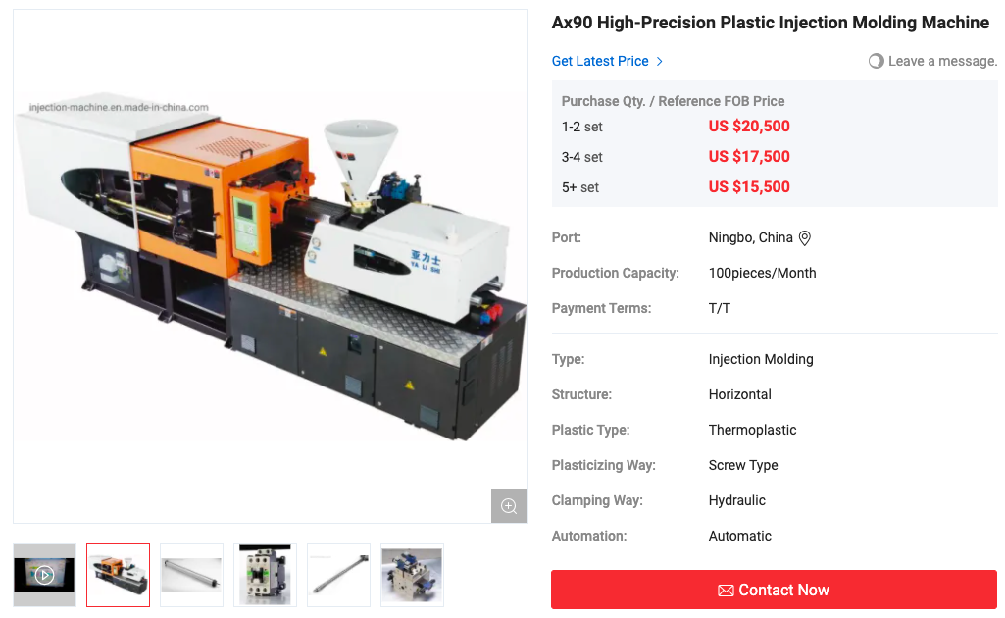

Part | # of units produced per lb. | Wastage per lb. | # of parts manufactured in one hour
Trigger | 20 | 10% | 200
Linkage | 40 | 10% | 250
Right side shell | 8 | 25% | 100
Left side shell | 8 | 25% | 100
Gripper | 12 | 10% | 200
Glue gripper | 15 | 15% | 250
PART | MATERIAL | AMOUNT (lb) | LIFE OF MOLD (# of pressing) | # of cavities
Trigger | ABS plastic | 0.03 | 125,000 | 4
Linkage | ABS plastic | 0.03 | 120,000 | 4
Right side shell | ABS plastic | 0.17 | 120,000 | 2
Left side shell | ABS plastic | 0.15 | / | /
Gripper | ABS plastic | 0.05 | 125,000 | 3
Glue gripper | ABS plastic | 0.01 | 125,000 | 4
Model | Capacity
AX-90B | 97g/s
https://injection-machine.en.made-in-china.com/product/vKoJUGHAIQfh/China-Ax90-High-Precision-Plastic-Injection-Molding-Machine.html

Slide 27
Summary of Manufactured Plastic Components
YR 1 & YR 2: (50,000 units)
Trigger: 278 hours; 13,889 pressing
Linkage: 223 hours; 13,889 pressing
Side Shells (Right & Left): 667 hours; 66,667 pressing
Gripper: 278 hours; 18,519 pressing
Glue Gripper: 236 hours; 14,706 pressing
YR 3 & YR 4: (60,000 units)
Trigger: 334 hours; 16,667 pressing
Linkage: 267 hours; 16,667 pressing
Side Shells (Right & Left): 800 hours; 80,000 pressing
Gripper: 334 hours; 22,223 pressing
Glue Gripper: 283 hours; 17,647 pressing
YR 5: (70,000 units)
Trigger: 389 hours; 19,445 pressing
Linkage: 312 hours; 19,445 pressing
Side Shells (Right & Left): 934 hours; 93,334 pressing
Gripper: 389 hours; 25,927 pressing
Glue Gripper: 330 hours; 20,589 pressing
3 Injection Molding Machines

Slide 28
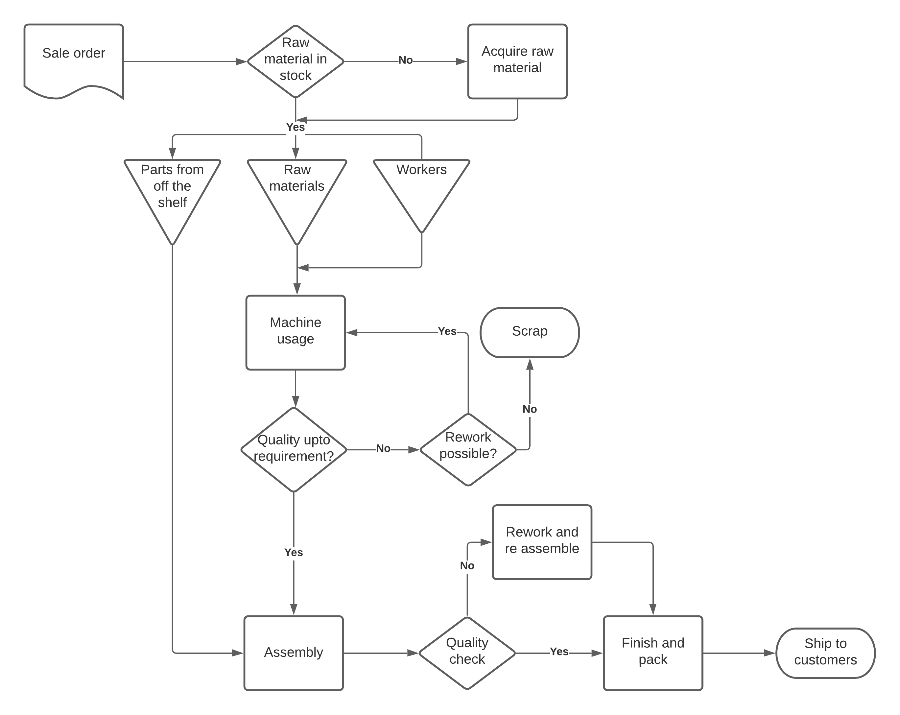
Process Flow chart

Slide 29
Task time
Task | Process | Task time(min)
1 | Take parts to assembly area | 0.3
2 | Assemble heater into side shell | 0.5
3 | Assembled linkage, trigger | 0.4
4 | Assembled glue gripper | 0.4
5 | Assembled tip | 0.3
6 | Assembled other side shell | 0.7
7 | Insert battery | 0.5
8 | Quality Control | 2
Total time |  | 5.1
IDEAL CYCLE TIME:
A total of 195 units is required per day. Factory will operate 1 shift per day at 90% efficiency. 195 units per shift.
Productive hours per shift= 8 hours per shift x 0.93efficiency = 7.44hour per shift
Desired Cycle time= 7.44 x 60/195= 2.289min, For 4 workers= 2.289 x 4= 9.156min

Slide 30
Precedence Table
Task number | Immediate predecessor | Task time
1 | - | 0.3
2 | 1 | 0.5
3 | 2 | 0.4
4 | 2 | 0.4
5 | 3 | 0.3
6 | 4,5 | 0.7
7 | 6 | 0.5

Slide 31
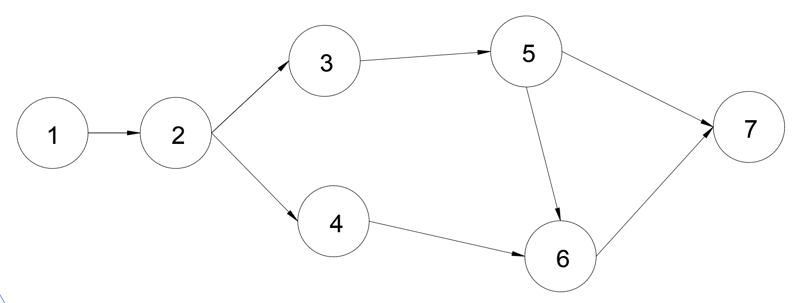
Assembly line Precedence Diagram

Slide 32
Facility Design

Slide 33
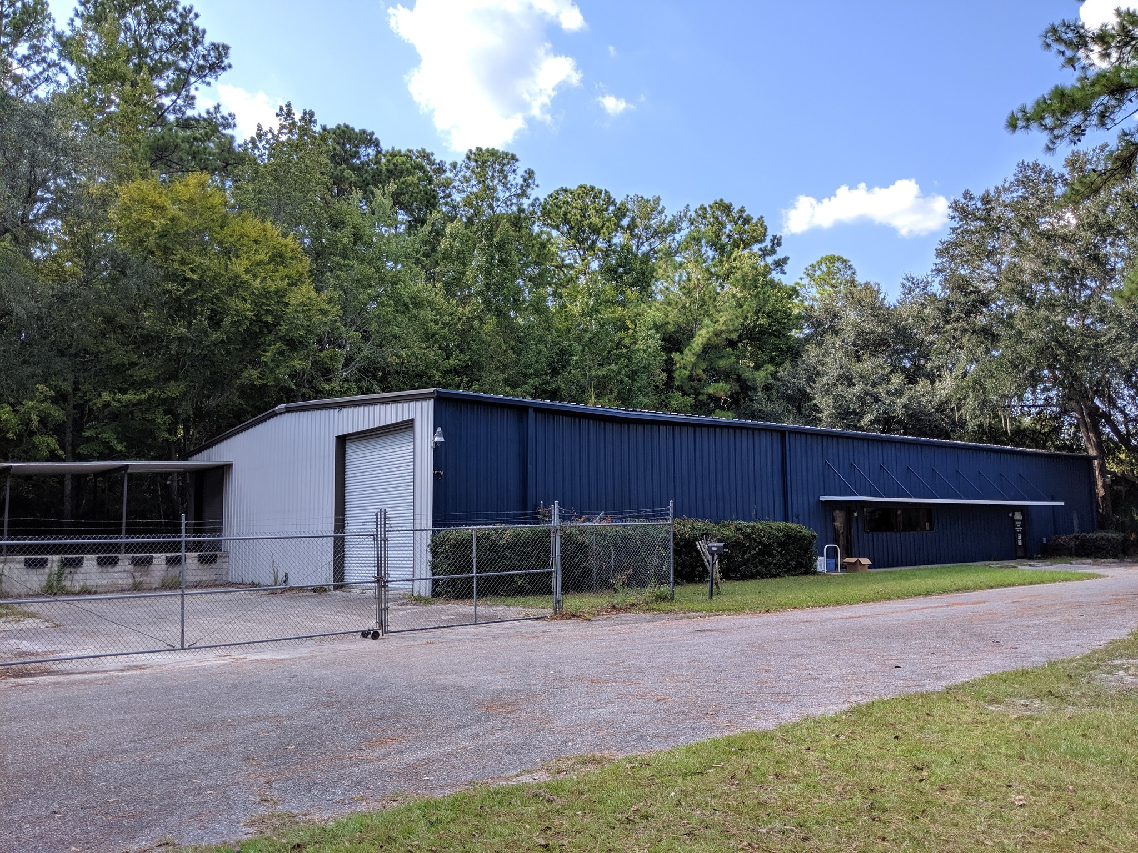
Facility
4750 NW US 441, Gainesville, FL 32609
7480 sq.ft

Slide 34
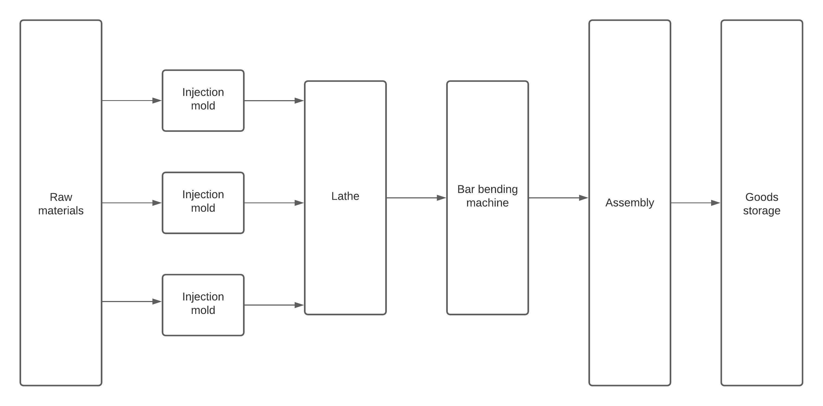
Plant Layout

Slide 35
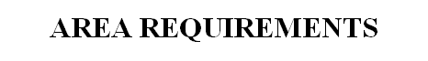
Production Areas:
Process | Equipment | Number | Dimensions ft | Area per unit Sq. ft | Total process area sq. ft
Lathe | CNC lathe | 1 | 5x2 | 10 | 10
Molding | Ax90 | 3 | 11.7x4.1 | 50 | 150
Bend | Bar bending machine | 1 | 3x3 | 9 | 9
Assembly |  | 1 | 30x40 | 1200 | 1200
Packaging |  | 1 | 20x40 | 800 | 800
 |  |  |  | Total | 1449
 |  |  |  | 50% aisles space | 991.1
 |  |  |  | Total area for production and assembly | 2173.5

Slide 36
Non-production areas:
Activity | Area sq. ft
Raw material Storage | 350
Finished good storage | 600
Office | 1250
Locker rooms | 270
Maintenance | 160
Tool crib | 160
Shipping and receiving | 600
Showroom | 1080
Restroom | 100
Total space required | 4570
Total area needed: 2173.5+4570 = 6743.5sq.ft

Slide 37
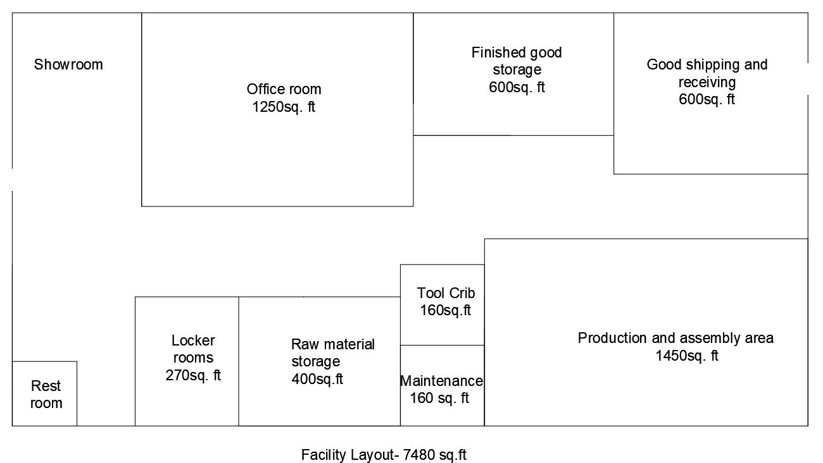
Floor Plan

Slide 38

Economic Analysis

Slide 39
Overall Initial Capital Investments
Labor Rate for four months
Role | Quantity | Price per person | Total
Technician | 4 | $13,325 | $53,300
Office Manager | 1 | $13,750 | $13,750
Office Assistant | 1 | $11,675 | $11,675
Engineer | 1 | $26,600 | $26,600
 |  | Total | $105,325

Slide 40
Overall Initial Capital Investment
Property Expenses
 | Size sqft | Price per sqft | Price per month | Total
Office/Warehouse Space for lease | 7480 | $0.58 | $4,338 | $17,353
Utility cost | 7480 | $2.10 | $15,708 | $62,832
Property/Liability Insurance |  |  | $80 | $320
Building Maintenance |  |  | $150 | $600
 |  | Total | $20,276 | $81,105

Slide 41
Overall Initial Capital Investment
Raw Material Costs | Quantity for 4 months | price per unit | Total
Abs Plastic | 10,000lbs | 1.5lb | $15,000
Aluminum 6061 T6 rod | 695 12" rods | 9.15 per foot | $6,359
Steel rod | 5,334 12" rods | 1.53 per foot | $8,161
COTS Costs | Quantity for 4 months | price per unit | Total
Spring | 16,667 | $2.38 | $39,667
Coupler | 16,667 | $1.30 | $21,667
Glue Gun heating element | 16,667 | $4.00 | $66,668
 |  | Total | $128,002

Slide 42
Overall Initial Capital Investment
Inventory= Amount needed for production + desired end inventory
Inventory
 | Amount needed for four months | Desired end inventory | Total Inventory | Total Price
Gripper | 16,667 | 7,333 | 24,000 | $21,600
Glue Gripper | 16,667 | 7,333 | 24,000
Trigger | 16,667 | 7,333 | 24,000
Linkage | 16,667 | 7,333 | 24,000
Right Side Shell | 16,667 | 7,333 | 24,000
Left Side Shell | 16,667 | 7,333 | 24,000
Tip | 16,667 | 7,333 | 24,000 | $9,150
Child Lock | 16,667 | 7,333 | 24,000 | $11,751
Spring | 16,667 | 7,333 | 24,000 | $57,120
Coupler | 16,667 | 7,333 | 24,000 | $31,200
Glue Gun Heating Element | 16,667 | 7,333 | 24,000 | $96,000
 |  |  | Total | $226,821

Slide 43
Overall Initial Capital Investment
Overall Investment for four months | Cost
Labor Rate | $105,325
Rent/Utilities | $81,105
Raw Materials | $42,501
COTS Parts | $184,320
Cost of Machinery | $65,000
Total Investment Cost | $478,251

Slide 44
Sales forecast and Margins
Year | Forecasted sales | Direct labor cost | Property expenses | Raw material cost | Cost of machinery | Total Investment | Gross margin | Net Margin | Total revenue
Year 1 | 50,000 | $421,300.00 | $243,312.00 | $384,006.00 | $65,000.00 | $1,113,618.00 | $828,700.00 | $136,382.00 | $1,250,000.00
Year 2 | 50,000 | $421,300.00 | $243,312.00 | $384,006.00 |  | $1,048,618.00 | $828,700.00 | $201,382.00 | $1,250,000.00
Year 3 | 60,000 | $505,560.00 | $243,312.00 | $460,807.00 |  | $1,209,679.00 | $994,440.00 | $290,321.00 | $1,500,000.00
Year 4 | 60,000 | $505,560.00 | $243,312.00 | $460,807.00 |  | $1,209,679.00 | $994,440.00 | $290,321.00 | $1,500,000.00
Year 5 | 70,000 | $589,820.00 | $243,312.00 | $537,608.00 |  | $1,370,740.00 | $1,160,180.00 | $379,260.00 | $1,750,000.00

Slide 45
Estimated Profit
Year | Sales | Net Margin | Tax(@37%) | Profit
Year 1 | 50,000 | $136,382.00 | $50,461.34 | $85,920.66
Year 2 | 50,000 | $201,382.00 | $74,511.34 | $126,870.66
Year 3 | 60,000 | $290,321.00 | $107,418.77 | $182,902.23
Year 4 | 60,000 | $290,321.00 | $107,418.77 | $182,902.23
Year 5 | 70,000 | $379,260.00 | $140,326.20 | $238,933.80

Slide 46
Estimated working capital
Working Capital = Cost of Goods Sold (Estimated) * (No. of Days of Operating Cycle / 365 Days) + Bank and Cash Balance
Working capital = $1,250,000*(300(excluding holidays)/365)+$250,000=$1,277,397.26

Slide 47

THANK YOU! Q&A

